Slide 1
Factors of progression to tertiary education
Fitri Amir - 2222811

Slide 2
CONTENTS OF THE ZIP FOLDER
Here’s what you’ll find in the zip folder submitted:
README.md: A document that allows viewers to understand the purpose of the project before they view the graphs.
datasetsInfo.ipynb: A file that allows viewers to see the details of the datasets used, such as the total amount of columns and rows.
Fitri-2222811.ipynb: The main python notebook that holds the plots of the datasets.
Datasets: A folder with all the data sets.

Slide 3
TABLE OF DATASETS
01
02
03
government-expenditure-on-education.csv
percentage-of-gce-o-level-students-who-passed-english-language.csv
percentage-of-o-level-cohort-that-progressed-to-post-secondary-education.csv
Notes:
Here I list the different datasets that I used in order to formulate my findings. In total, I used 6 datasets

Slide 4
TABLE OF DATASETS
04
05
percentage-of-p1-cohort-that-progressed-to-post-secondary-education.csv
pupils-per-teacher-in-primary-schools.csv

Slide 5
VALUES IN ALL THE DATASETS
 | DATA 1 | DATA 2 | DATA 3
government-expenditure-on-education.csv | year | total_expenditure_on_education -the values are too huge, hence I divided it by 1000000 before plotting to fit | -
percentage-of-gce-o-level-students-who-passed-english-language.csv | year | race | percentage_pass_eng -the earlier data are significantly lower than the more recent years
percentage-of-o-level-cohort-that-progressed-to-post-secondary-education.csv | year | race | percentage_progress_postsec -similarly, the earlier data are significantly lower than the more recent years

Slide 6
VALUES IN ALL THE DATASETS
 | DATA 1 | DATA 2 | DATA 3
percentage-of-p1-cohort-that-progressed-to-post-secondary-education | year | race | percentage -some values for the others category are na, so I used missing_values=['na','-'] ,filling_values=0 to fill up the values.
 |  |  | - I also marked out the median and outliers in the datasets
pupils-per-teacher-in-primary-schools | year | sec_pupil_to_teacher -all of the values are in float, and there are far outliers that I marked out. | -

Slide 7
MAIN FOCUS

Slide 8
What are the factors that affect the progression of students to tertiary education?

Slide 9
What I did for all the datasets used the all the analyses:
-Using Numpy: I wrangled all the data by using empty arrays and had an easier time referring to the more recent data by using indexing, mainly using the syntax of [::-5] in order to refer to more recent years.
It also helped me to fetch the data sets ,fill up null values and display the information of every dataset. (datasetInfo)
-Using Matplotlib: I was able to source a style specially made for Matplotlib called ‘ggplot’, link included in the final slide. It helped me to mark out the axes, plot the graphs, label the axes, and color the different values I used to analyse the data.
The style helped me to mark out grids in the graphs I plot so that I am able to clearly analyse the data.

Slide 10
01
ENGLISH VS PASS RATE
(for O Level students)

Slide 11
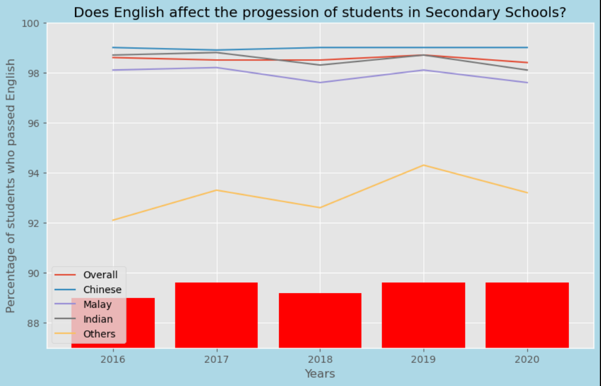
Analysis 1

Slide 12
Analysis 1
-In this analysis, I used a bar graph and line graph to compare the amount of students who passed English in O Levels to the O Level cohort that progressed to tertiary education.
-Used a line graph for the O Level cohort as it is easier to compare the different races and the overall value. I plotted the wrangled data in the last 5 years using the syntax [-5::]. Matplotlib helped me to color the different lines and create a legend to differentiate the races and overall results.
- In 2018, as the pass rate of English decreased, the students who progressed decreased as well. In 2019, the pass rate of English increased as the number of students who progressed increased.
-Hence, we can conclude that there is a linear relationship between the passing rate of English and students who progress to tertiary education.

Slide 13
02
RATIO OF STUDENTS VS PASS RATE
(for O/N Level students)

Slide 14
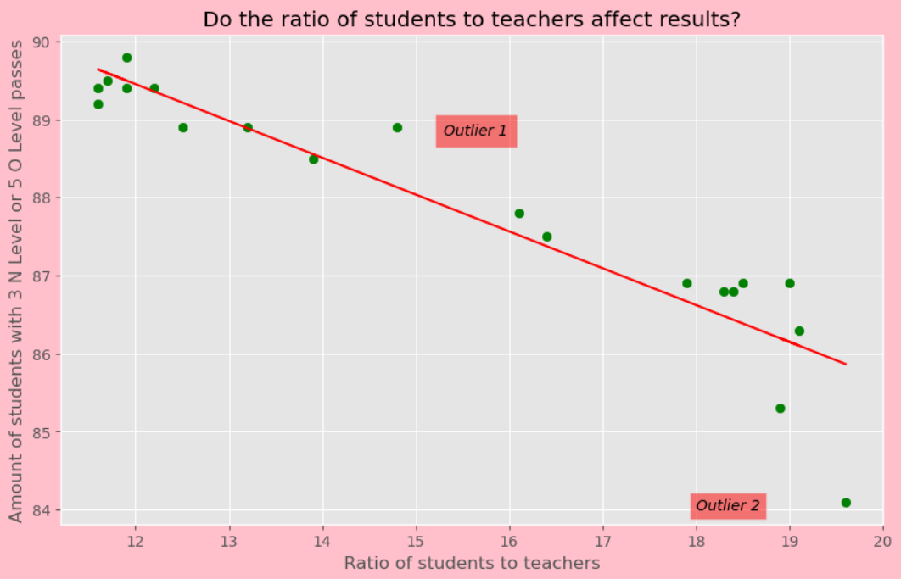
Analysis 2

Slide 15
Analysis 2
-In this analysis, I used a scatter plot to compare the ratio of students to teachers in secondary school to the O/N Level pass rate.
-Used a scatter plot so that the relationship between both data values are clearer. Matplotlib allowed me to mark out the outliers
- There are some outliers marked, specifically outlier 1 was marked as the students had a high passing rate despite having a high teacher-student ratio, and outlier 2 where there was a very high teacher-student ratio but the students had a low passing rate that was lower than expected. (comparing to the other values with a similar ratio)
-Hence, we can conclude that there is a linear relationship between the ratio of teachers and O/N level pass rate, however there are clear outliers in certain batches.

Slide 16
03
EXPENDITURE VS PROGRESSION RATE
Depending on students from the P1 cohort

Slide 17
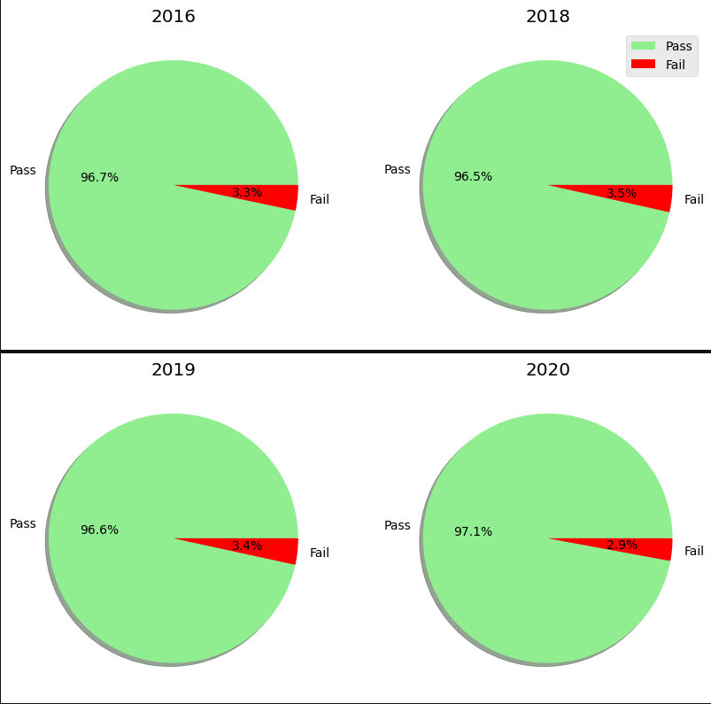
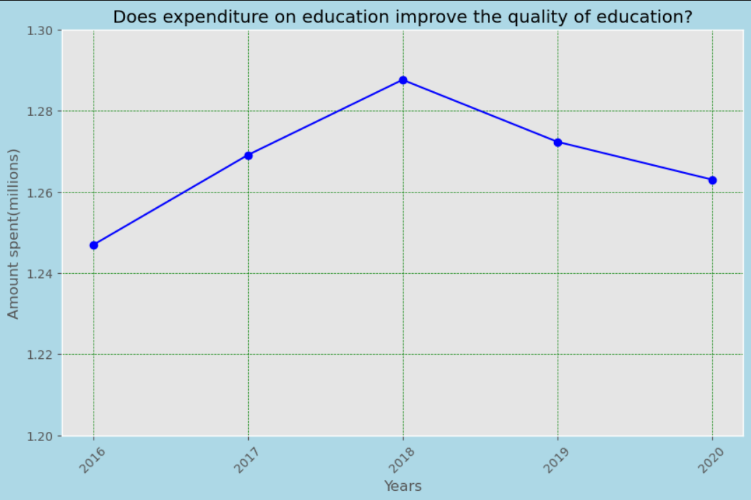
Analysis 3

Slide 18
Analysis 3
-In this analysis, I used a pie chart and line graph to compare the government expenditure on education to the p1 cohort that went to tertiary education.
-Using a line chart makes the changes more distinct, and the pie charts clearly show the pass/fail rate from the colors used as it shows the parts-to-whole relationship.
-We can see clear outliers here; in 2018 the pass rate was the lowest despite having the highest expenditure. However, from the events that happened in the year (the removal of mid year examinations from the curriculum in certain levels) the results become explanatory.
- From both graphs, we can see that the relationship between the government expenditure to the pass rate is quite weak, but there are explanations to it such as using the money to better the equipments in school, rather than focusing on the “curricular” side of the schools.

Slide 19
04
RACE VS PROGRESS
Which race has done the best in Singapore

Slide 20
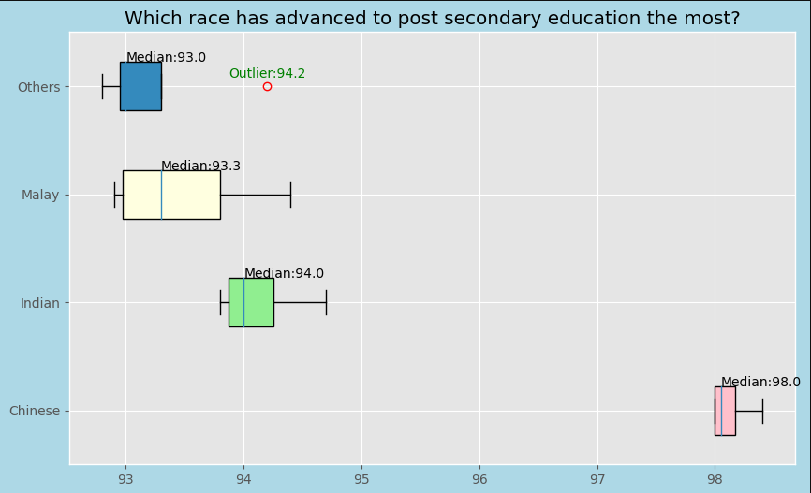
Analysis 4

Slide 21
Analysis 4
-In this analysis, I used a box plot to show how all the races in Singapore are doing in terms of education.
- Using a box plot allows me to see not only the outliers, but also the median of the percentage that progress in Singapore. I used numpy in order to find and mark the outliers and median in the box plot, allowing easier analysis.
-As the ‘others’ column had empty values in the earlier years, I replaced them with zeros, but it was not displayed in the boxplot as I only wanted to show the most recent values, which was only possible using indexing.
- We can see that the Chinese community has the most consistent and highest percentage, while the Malay community has the least consistent percentage. There is an outlier in the Others community where they had a very high percentage in one of the years.

Slide 22
RESOURCES
Links to the data sets used in this assignment:
https://data.gov.sg/dataset/government-expenditure-on-education
https://data.gov.sg/dataset/percentage-of-gce-o-level-students-who-passed-english-language?resource_id=83281660-6202-476d-bf31-af13a7c3da4c
https://data.gov.sg/dataset/percentage-of-o-level-cohort-that-progressed-to-post-secondary-education
https://data.gov.sg/dataset/percentage-of-p1-cohort-admitted-to-post-secondary-and-tertiary-education-by-type-of-course
https://data.gov.sg/dataset/pupils-per-teacher-in-primary-and-secondary-schools
https://data.gov.sg/dataset/percentage-of-p1-cohort-who-had-at-least-5-n-level-passes-or-3-o-level-passes
Style mentioned in slide 9:
https://matplotlib.org/stable/gallery/style_sheets/style_sheets_reference.html

